Slide 1

WIPRO NGA Program – .Net FullStack
Capstone Project Presentation – 14-06-2025
Project Title Here - BUG TRACKING SYSTEM (MVC - Single Controller)
Presented by - G NANDINI - 27374
www.rpsconsulting.in

Slide 2


Capstone Project: Bug Tracking System (MVC - Single Controller)
Project Overview:
Create a basic bug tracker where users can log software bugs/issues. The system allows tracking bug status, severity, and assignee in a clean interfac.
Table of Contents
1. Features:
Add a new bug report
View list of all bugs
Edit bug details (e.g., status, severity)
Delete bug entries
View individual bug detail
2025 - RPS Consulting all rights reserved

Slide 3
Capstone Project: Bug Tracking System (MVC - Single Controller)
2. Technologies Used
ASP.NET Core MVC
Entity Framework Core
SQL Server
Razor Views + Bootstrap
Azure App Service (Deployment)
Git for version control
2025 - RPS Consulting all rights reserved

Slide 4
Capstone Project: Bug Tracking System (MVC - Single Controller)
3. Database Schema:
Bug Table
Field Name Type
Id int (PK)
Title string
Description string
Severity string (Low, Medium, High)
Status string (Open, In Progress, Closed)
Assignee string
ReportedDate DateTime
2025 - RPS Consulting all rights reserved

Slide 5
Capstone Project: Bug Tracking System (MVC - Single Controller)
4. Controller
BugsController.cs
Handles:
Index() – Show list of all bugs
Create() – Submit a new bug
Edit(id) – Update bug details (e.g., status/severity)
Details(id) – View bug details
Delete(id) – Delete bug record
2025 - RPS Consulting all rights reserved

Slide 6
Capstone Project: Bug Tracking System (MVC - Single Controller)
5. Views Views/Bugs/
├── Index.cshtml
├── Create.cshtml
├── Edit.cshtml
├── Details.cshtml
└── Delete.cshtml
2025 - RPS Consulting all rights reserved

Slide 7
Capstone Project: Bug Tracking System (MVC - Single Controller)
6. Folder Structure
BugTrackingSystem/
|── Controllers/
| └── BugsController.cs
|── Models/
| └── Bug.cs
|── Views/
| └── Bugs/
|── Data/
| └── ApplicationDbContext.cs
2025 - RPS Consulting all rights reserved

Slide 8
Capstone Project: Bug Tracking System (MVC - Single Controller)
7. Deployment
Push to GitHub
Deploy to Azure App Service
Use Azure SQL Database
Configure appsettings.json with cloud DB connection
8. Documentation
Setup and usage instructions
Screenshot of the bug list and form
Deployment steps
2025 - RPS Consulting all rights reserved

Slide 9
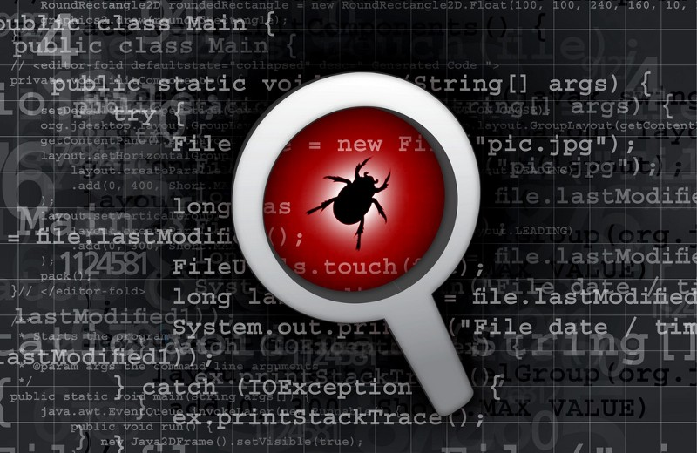

Slide 10
Introduction
Bug tracking systems are a crucial part of any software development team. Without a good bug tracking systems, you may find it difficult to track the progress of your projects, identify and fix bugs quickly, and provide a quality product to your customers.
What is Bug Tracking?
Bug tracking is the process of documenting and managing the issues that occur while using a software application. Bugs can be categorized as functional, nonfunctional, or unknown.
Functional bugs refer to problems with the user interface or functionality of the application. Nonfunctional bugs refer to problems with how the application behaves, such as errors or crashes. Unknown bugs are those that have not been assigned a particular bug category.
2025 - RPS Consulting all rights reserved

Slide 11
Introduction
What is Bug Tracking System ?
A Bug Tracking System is a software application that helps you track issues and bugs in your software. It can help you to resolve issues quickly and efficiently, and it can also help you to improve the quality of your software.
There are a few different types of bug tracking systems, but the most reliable one is probably Disbug. Disbug offers a chrome extension and a website feedback widget which smoothes the entire process of bug reporting, and it is used by hundreds of software teams all over the world.
Bug tracking systems are essential for any software company, and they can help you to improve your product quality, customer support, and overall profitability.
2025 - RPS Consulting all rights reserved

Slide 12
Common types of Bugs
Syntax bugs: Breaking the rules of the programming language.
Logical bugs: Code runs without errors but produces incorrect results.
Runtime errors: Crashes during execution (e.g., null references, division by zero).
UI bugs: Elements not displaying or behaving correctly.
Integration bugs: Issues when different systems or modules interact.
Performance Bugs: Slow execution, excessive memory or CPU usage, lagging user interactions—often due to inefficient algorithms, memory leaks, or poor caching/practices
Compatibility Bugs: Software works in one environment (browser, OS, device) but fails or behaves unexpectedly in others—think CSS issues across browsers or OS-specific behaviors .
2025 - RPS Consulting all rights reserved

Slide 13
Benefits of using a bug tracking system
Bug tracking systems have many benefits that can make your life as a software developer or software tester much easier. Here are just a few of the most important ones:
1. Bug tracking systems help you stay organized. Since you can track all the bugs that are related to a specific project, you will be able to identify and fix them faster. This will save you time and keep your codebase clean and tidy.
2. Bug tracking systems help you track the progress of projects. By knowing which bugs have been fixed and which ones are still pending, you will be able to better measure the success or failure of a project. This is especially important if you are working on a project that has deadlines attached to it.
2025 - RPS Consulting all rights reserved

Slide 14
Benefits of using a bug tracking system
3. Bug tracking systems help you findbugs quickly. Since all the bugs related to a particular project are stored in one place, it will be easy to find the bug that you're looking for. This can save you a lot of time and hassle when trying to track down a bug that is causing problems in your codebase.
4. Bug tracking systems provide feedback to developers and testers. By automatically sending notifications whenever a bug is fixed or new bugs are found, bug tracking systems help developers and testers receive feedback as soon as possible. This helps them to better understand the issues that they're facing and resolves them faster - saving both time and money in the process.
2025 - RPS Consulting all rights reserved

Slide 15
What should a bug tracking system include?
A bug tracking system is a great way to keep track of all the bugs that are reported by your users. It ensures that the issues that are reported are properly documented, tracked, and resolved as quickly as possible. Here are a few features that a good bug tracking system should have:
1. A user-friendly interface - The interface should be easy to use and intuitive, so that everyone in the company can access it.
2. Automatic email notification - Whenever a bug is reported or resolved, the system should send an email notification to all involved parties. This will help keep everyone informed and focused on the issues at hand.
2025 - RPS Consulting all rights reserved

Slide 16
What should a bug tracking system include?
3. Detailed reports - The reports should include all the information necessary to understand the bug history, such as the date, time, user information, and more. This will help you track trends and make informed decisions about how to handle future issues.
4. Automated resolution workflow - The system should have an automated resolution workflow so that all bugs are resolved as quickly as possible. This will help to prevent any major delays or disruptions in your workflow and ensure that your users are always happy and satisfied with your product.
2025 - RPS Consulting all rights reserved

Slide 17
Steps to follow for doing the Project:
Step-1: Open the Visual Studio 2022 and click on Create New Project.
Create the new project names with PROJECTS.
Step-2 : In model create a class with Bug.cs and define the fields in that.
Step-3 : Create a controller.
Step-4 : In package manager console run the below commands.
Add-Migration InitialCreate
Update-Database
Step-5 :Run the controller a basic web application will run in the browser.
2025 - RPS Consulting all rights reserved

Slide 18
Steps to follow for doing the Project:
Step-6 : Add the style part to the code for
Views/Bugs/Index.cshtml
Views/Bugs/Edit.cshtml
Views/Bugs/Details.cshtml
Views/Bugs/Create.cshtml
Views/Bugs/Delete.cshtml
Step-7 : Modify the code for Views/Home/Index.cshtml, then run the code.
2025 - RPS Consulting all rights reserved

Slide 19
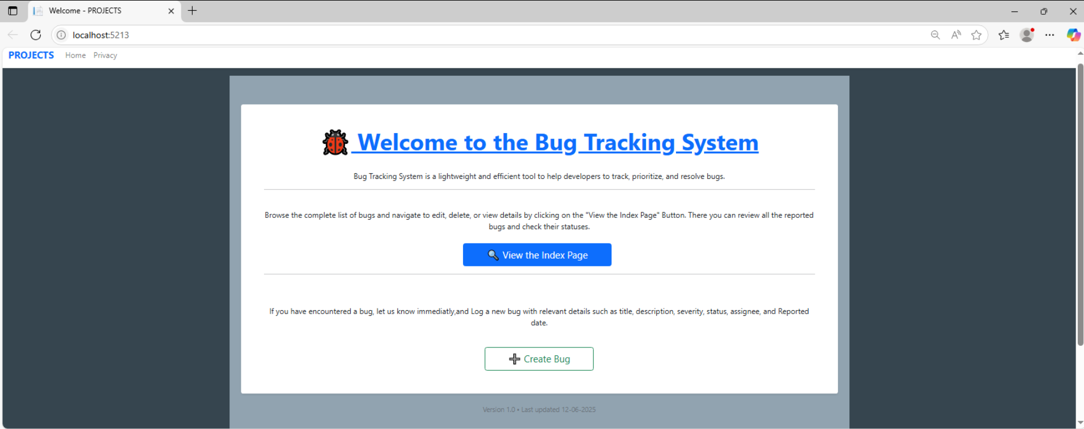
Home page - Output
2025 - RPS Consulting all rights reserved

Slide 20
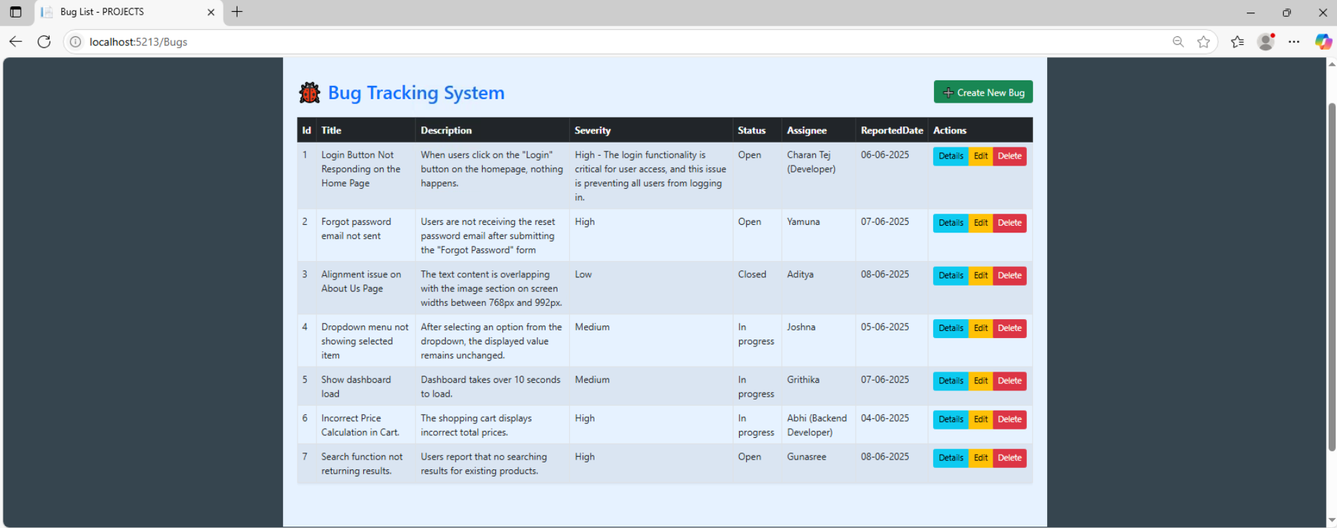
Index Page
2025 - RPS Consulting all rights reserved

Slide 21
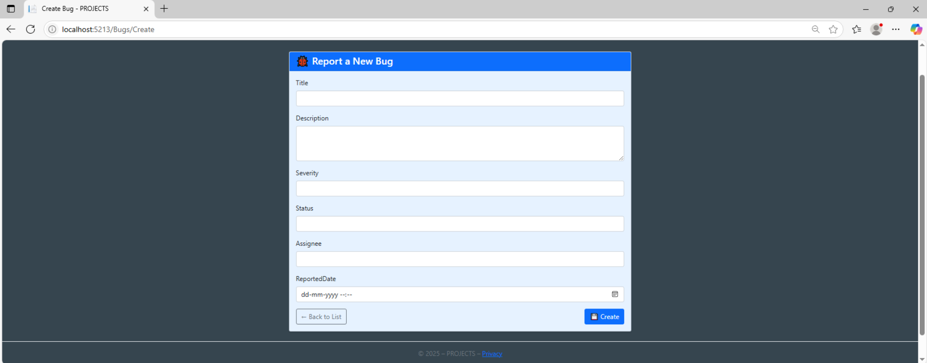
Create page
2025 - RPS Consulting all rights reserved

Slide 22
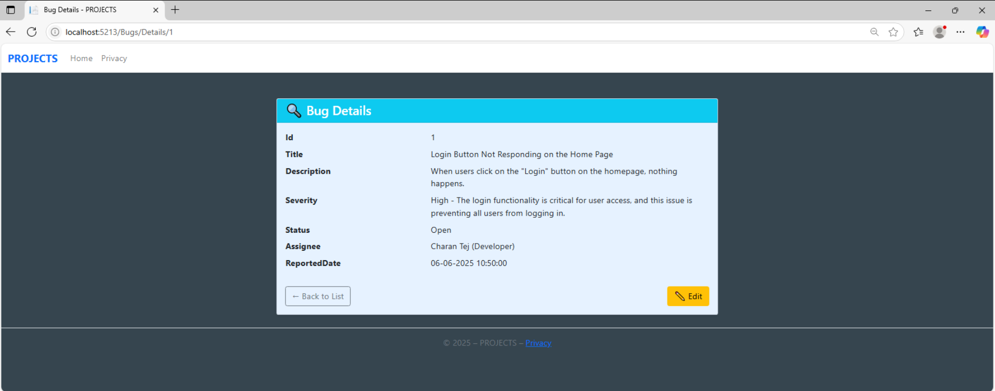
Details page
2025 - RPS Consulting all rights reserved

Slide 23
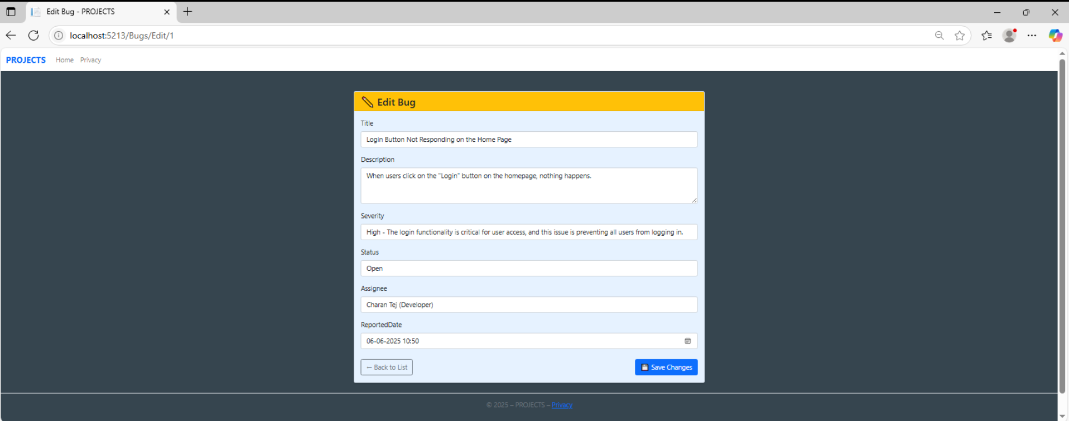
Edit page
2025 - RPS Consulting all rights reserved

Slide 24
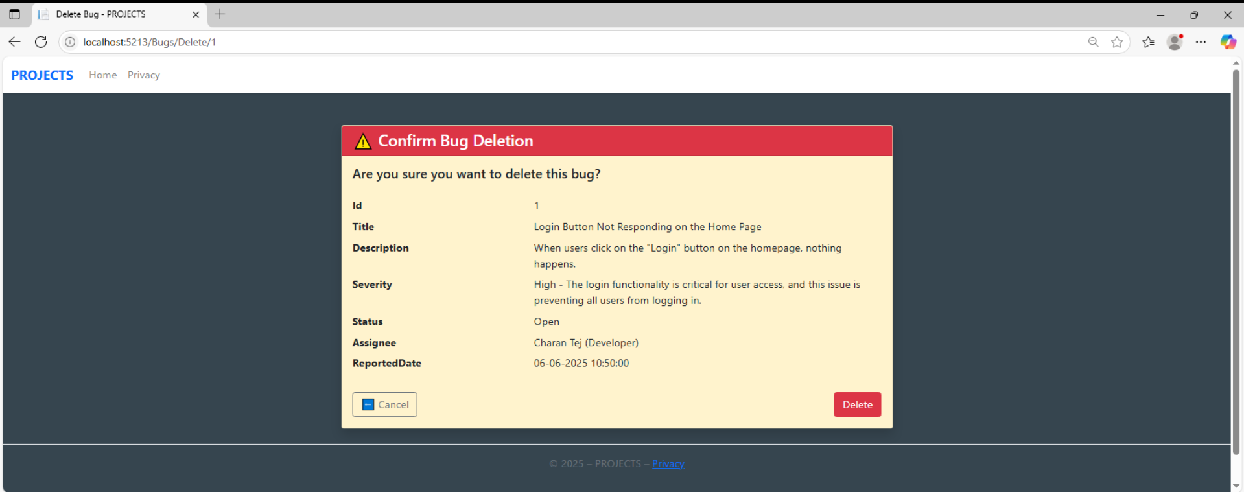
Delete page
2025 - RPS Consulting all rights reserved

Slide 25
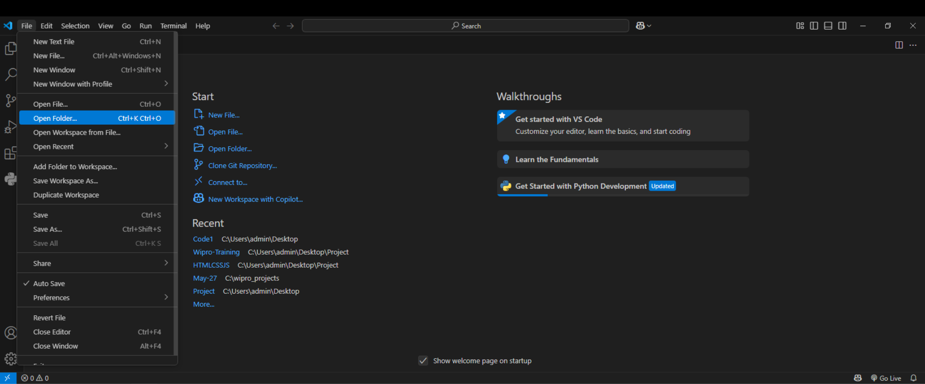
Deployment Steps
Step-1 : Create a folder in the File Explorer.
Step-2 : Open that folder in Visual Studio Code.
2025 - RPS Consulting all rights reserved

Slide 26
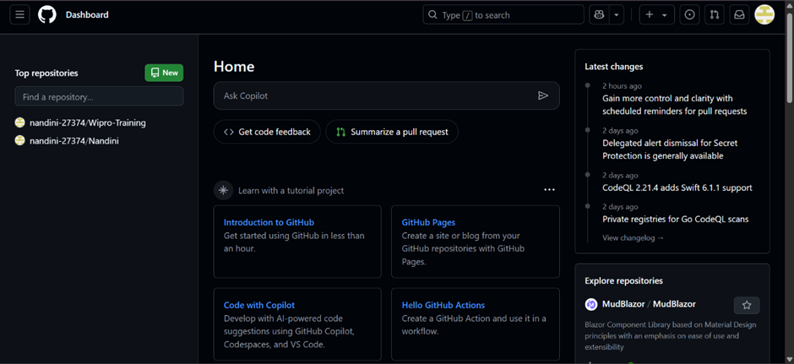
Deployment Steps
Step-3 : Go to the Git Hub home page
2025 - RPS Consulting all rights reserved

Slide 27
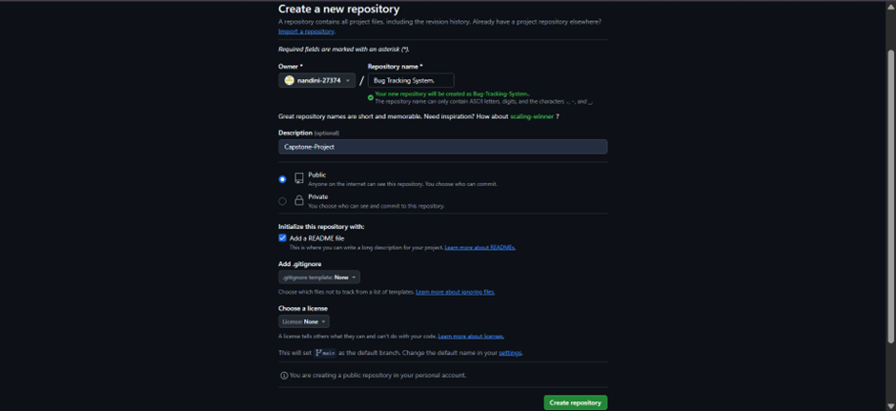
Deployment Steps
There we can see the “New” ,click on it it will navigate to another page.
2025 - RPS Consulting all rights reserved

Slide 28
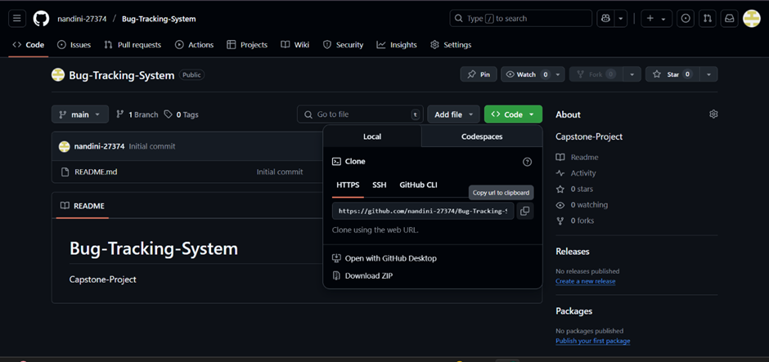
Deployment Steps
Step-4 : It will ask for Repository name after that, Description is optional.
Here Repository name is “Bug Tracking System” and Description as “Capstone-Project”.
Step-5 : Select the Public and README file, then Click on “Create Repository”.
A new repository is created with name Bug Tracking System.
2025 - RPS Consulting all rights reserved

Slide 29
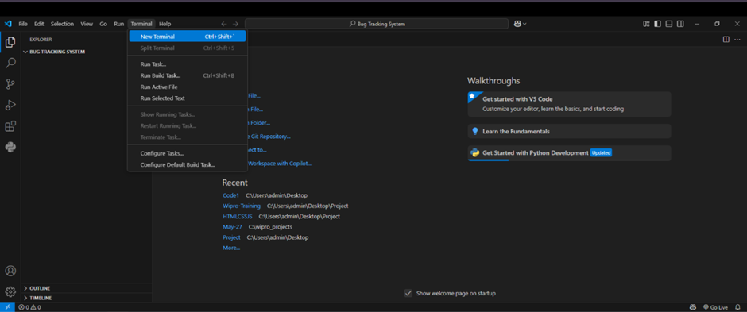
Deployment Steps
Step-6 : Go to the VS Code then open the new terminal
2025 - RPS Consulting all rights reserved

Slide 30
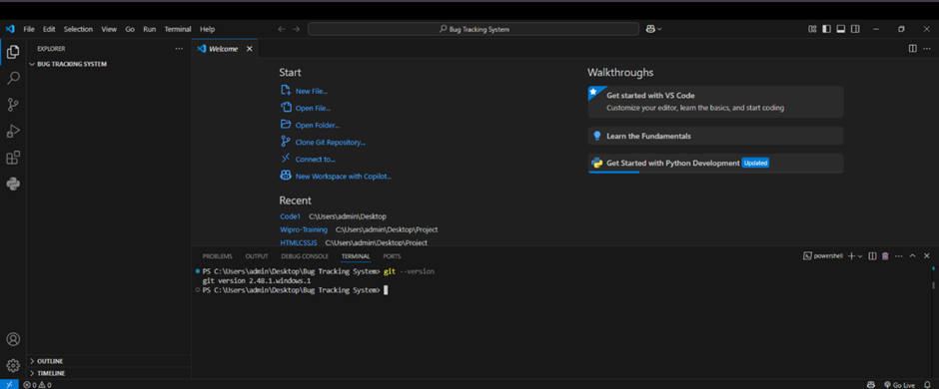
Deployment Steps
After clicking new terminal a new window will come.
2025 - RPS Consulting all rights reserved

Slide 31
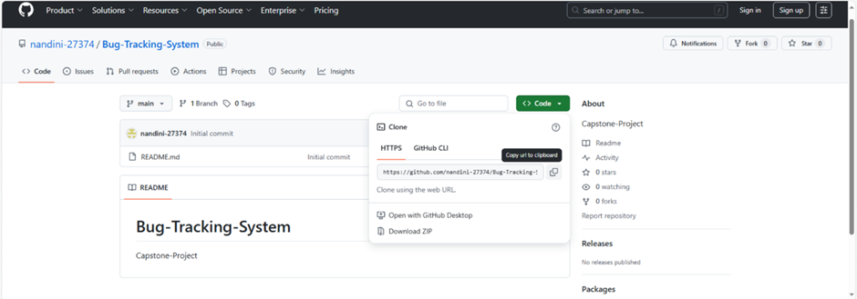
Deployment Steps
Step-7 : Go to the Git Hub newly created repository and copy that clone link.
2025 - RPS Consulting all rights reserved

Slide 32
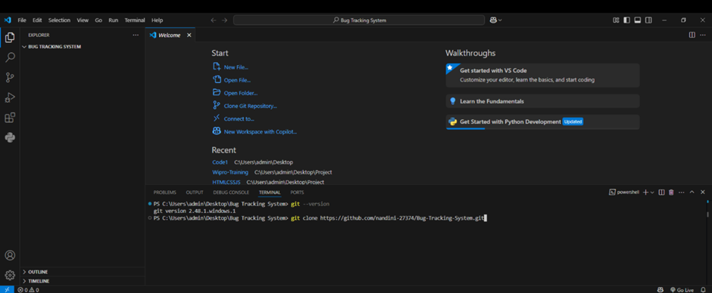
Deployment Steps
Step-8 : Now come to Visual Studio code , In terminal paste the link.
2025 - RPS Consulting all rights reserved

Slide 33
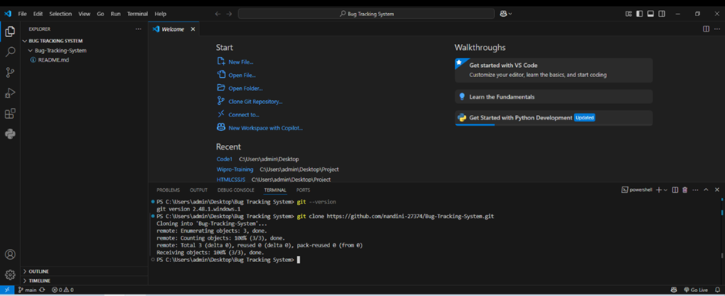
Deployment Steps
Now give enter.
2025 - RPS Consulting all rights reserved

Slide 34
Deployment Steps
Now we can see at the left side corner we can see the “Bug Tracking System” which we have created in the Git Hub.
Step-9 : Copy the files that you want to push into the GIT Hub.
Go to admin in the desktop there search for source from there you can find the
PROJECTS web application.
And also copy the word doc containing setup and usage instructions, Deployment steps,
Screenshots of the outputs also ppt .
Paste into Bug Tracking System folder.
2025 - RPS Consulting all rights reserved

Slide 35
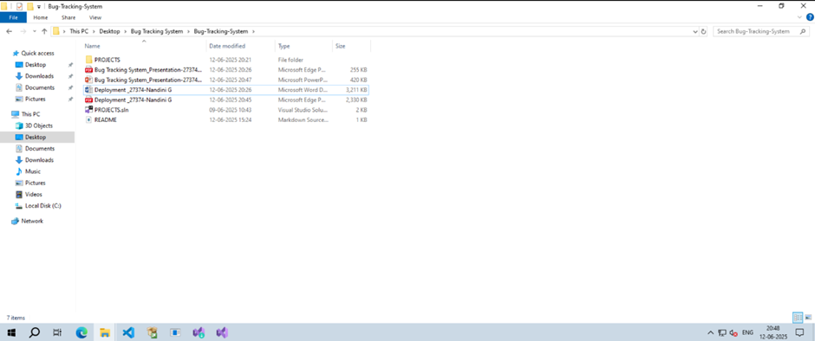
Deployment Steps
2025 - RPS Consulting all rights reserved

Slide 36
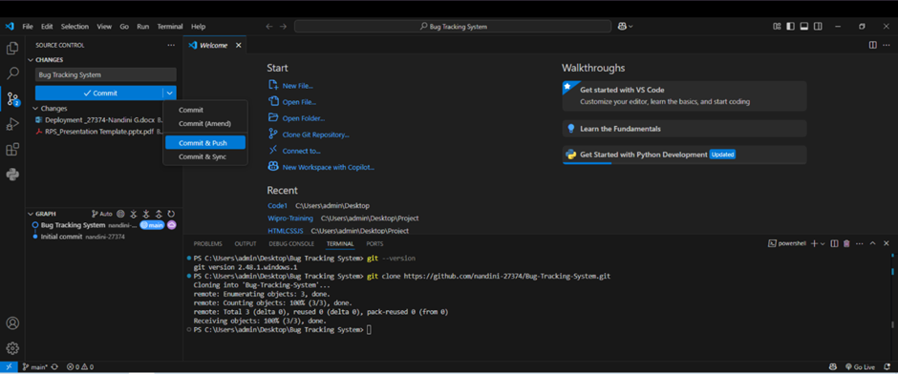
Deployment Steps
Step-10 : Go to visual studio code there you can see source control is having some action.
2025 - RPS Consulting all rights reserved

Slide 37
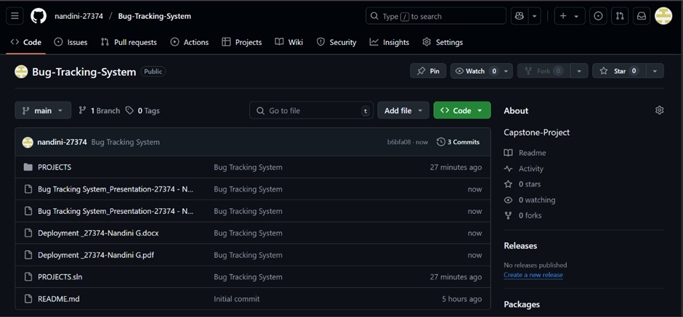
Deployment Steps
There give a commit and select commit & push.
Refresh the GIT Hub you can see the files there.
2025 - RPS Consulting all rights reserved

Slide 38
Conclusion
The whole process of tracking bugs is not easy, especially when it comes to managing hundreds of issues at the same time. Hence we have listed down everything that you need to know about bug-tracking systems as well as how and why they can help.
These solutions can keep your team focused on quality work and ensure timely resolution of all the issues you face. Thus, make sure not to skip a step in your bug-tracking journey. Keep reading our blog for more knowledge related articles.
2025 - RPS Consulting all rights reserved

